Slide 1

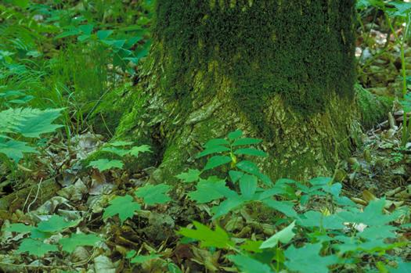
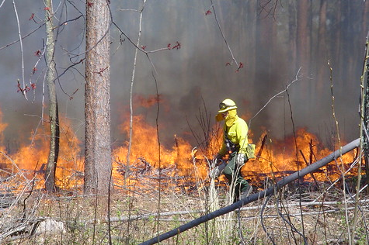
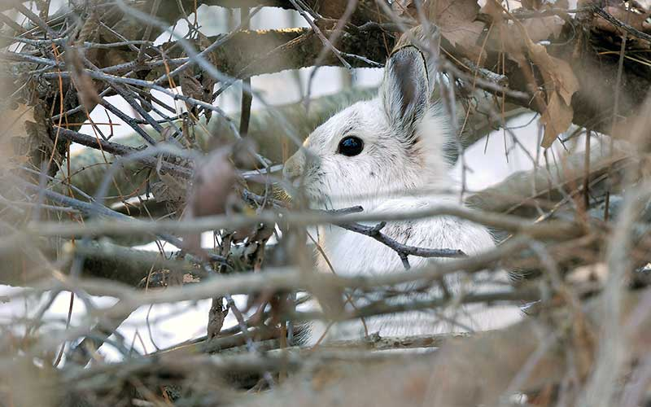
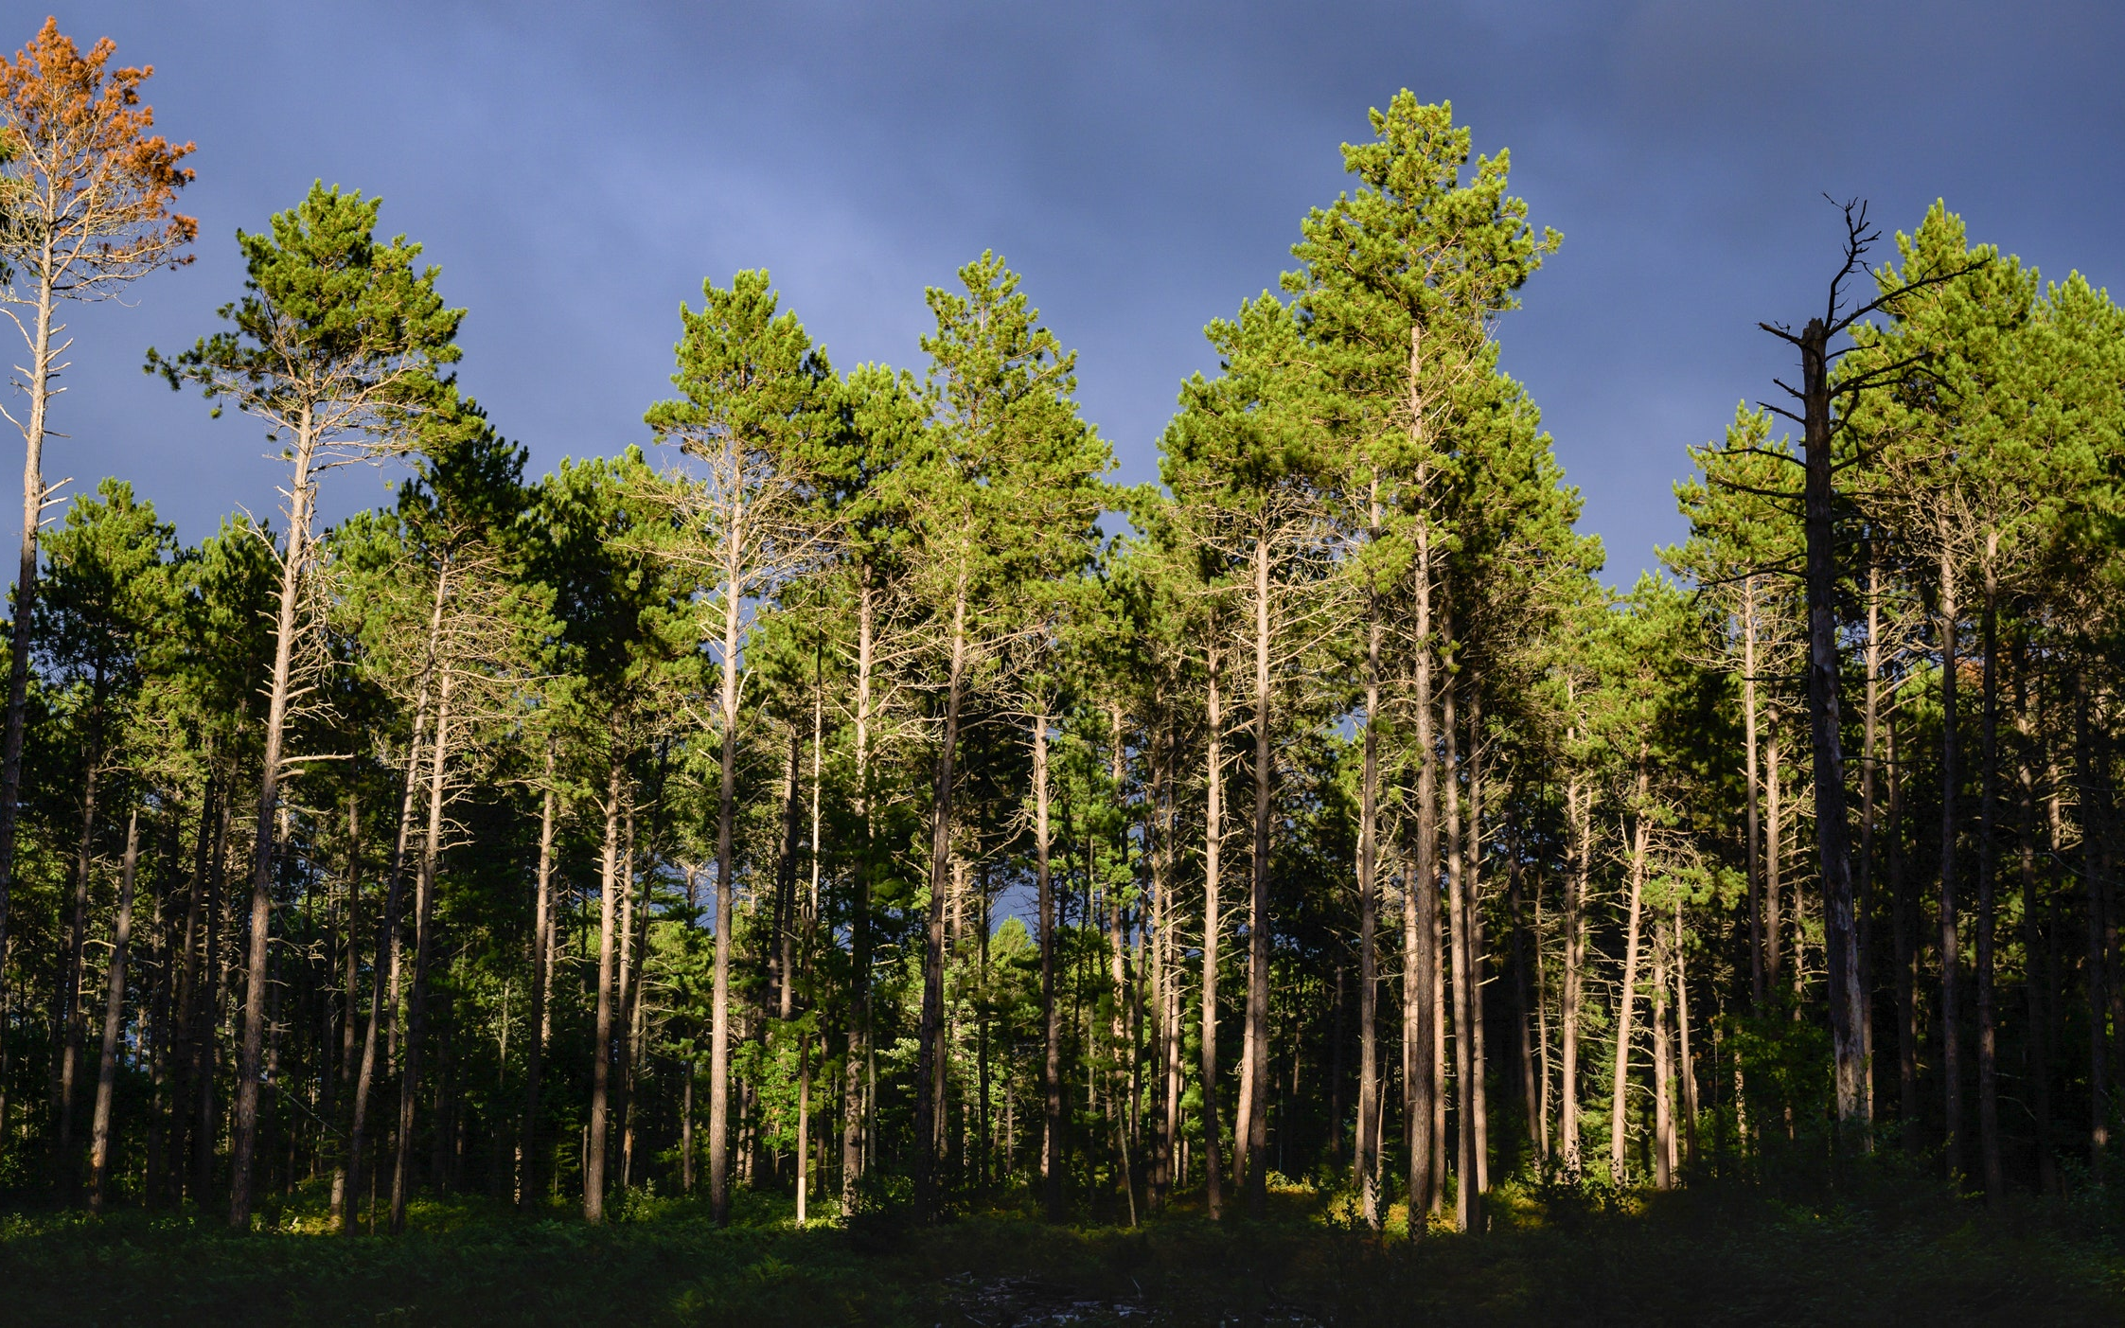

Climate Change and the Chippewa
National Forest Winnie Sand Project
May 2022

Slide 2









Northern Institute of Applied Climate Science
The Northern Institute of Applied Climate Science (NIACS) develops synthesis products, fosters communication, pursues science, and provides technical assistance in climate change adaptation and carbon management.
Climate
Carbon
Multi-institutional collaborative chartered by USDA Forest Service, universities, and non-profit and tribal conservation organizations

Slide 3
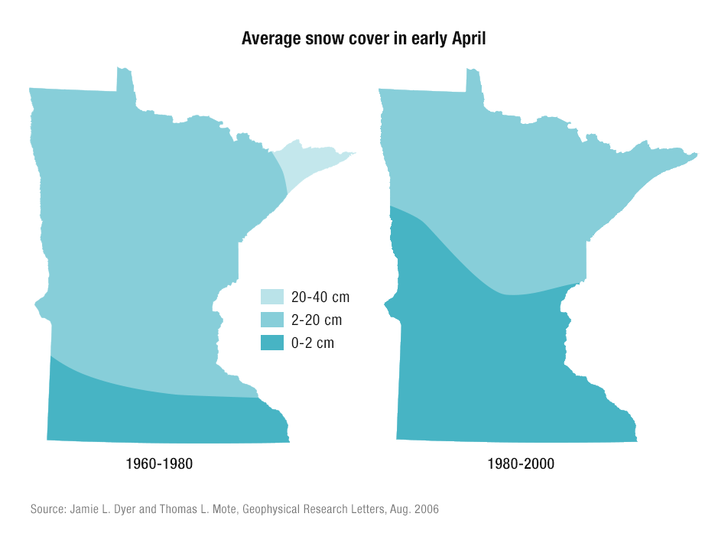
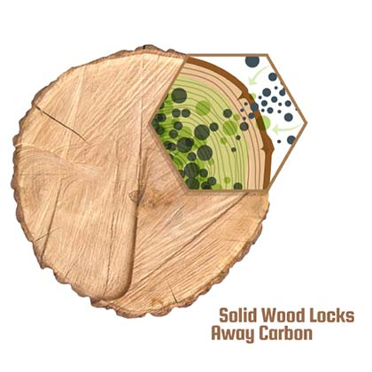
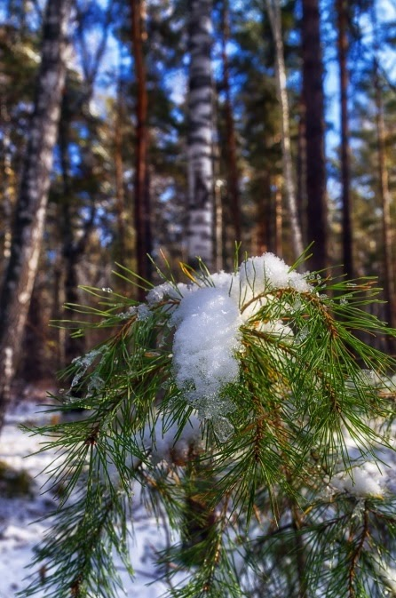
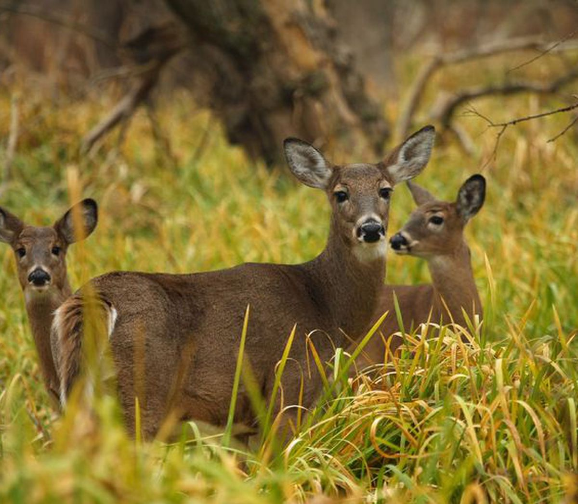
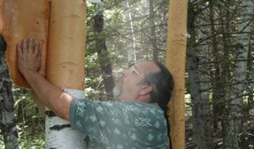
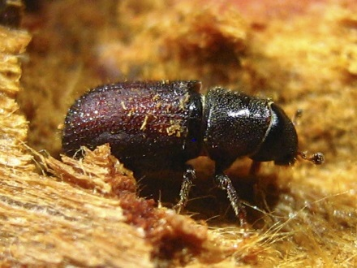
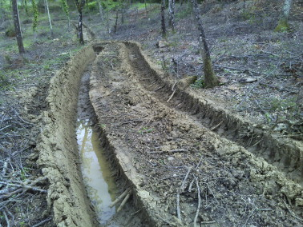
Climate Change: It’s everywhere you look
GLIFWC
Notes:
Lake States:
we’re on the leading edge of climate change in many respects (our winters have the fastest rate of change in the lower 48)
We’re not on the “razors” edge” like some forested regions in the southwest, but we can look to those places for clear signals regarding the diverse ways that climate change can influence forest ecosystems
Our forest ecossytems evolved to tolerate and compete within a climate with 4 distinct seasons, cold and prolonged winters, etc.
Ongonig and continued climate change will have numerous ecological effects
Climate change will also affect the way we conduct forest management, as the entire forest supply chain can be affected by swings and shifts in our seasonal conditions and episodic events. Add to this that some of our most valuable forest types (aspen, red pine) may be more vulnerable to climate change.
We also recognize that forests in our region are critical to sustaining numerous ecosystem services that people care about – wildlife habitat, clean water, recreational opportunity, cultural relationships, and (more recently) carbon storage
Certification standards!

Slide 4
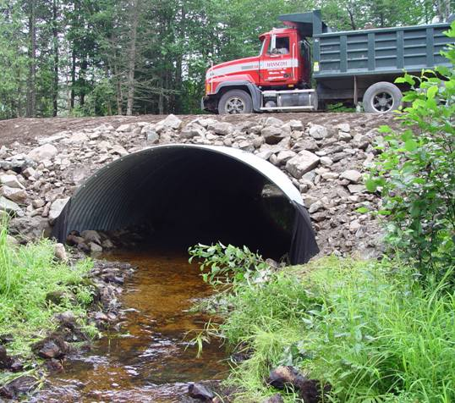
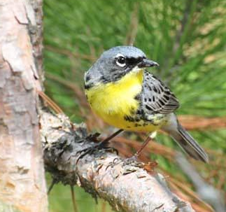
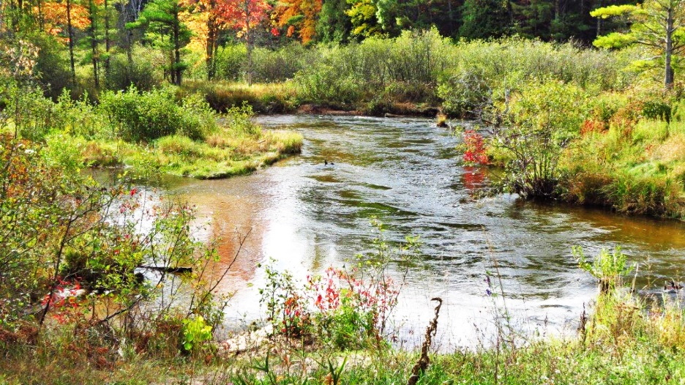
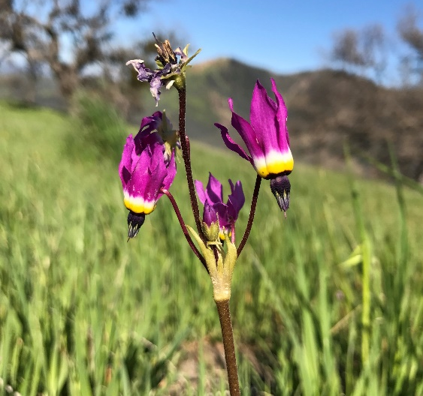
Adaptation is the adjustment of systems in preparation or in response to climate change.
Adaptation actions are designed to intentionally address climate change impacts and vulnerabilities in order to meet goals and objectives
Notes:
Before we dive into the course, let’s start by defining ADAPTATION (read slide)
the adaptation activities will build upon sustainable forest management and conservation IN MOST CASES. Much of what we’re already doing also makes good sense as a response to climate change.

Slide 5
Adaptation is the adjustment of systems in preparation or in response to climate change.
Ecosystem-based adaptation actions build on sustainable management, conservation, and restoration.
Notes:
Before we dive into the course, let’s start by defining ADAPTATION (read slide)
the adaptation activities will build upon sustainable forest management and conservation IN MOST CASES. Much of what we’re already doing also makes good sense as a response to climate change.

Slide 6
Two Key Questions
How might climate change affect the resources that I manage?
What management actions could help prepare for those effects?
Notes:
Climate change is real and we are already living with the effects. There is, and always will be, uncertainty about the future. But we know enough now to begin preparing. Climate change might not be the biggest threat to our forests, but it’s something that we all should stop and consider as we do our jobs and manage our woods.

Slide 7
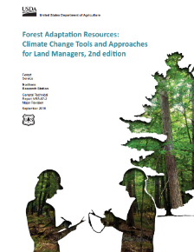
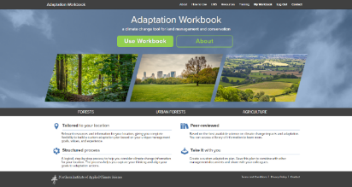
Forest Adaptation Resources
A flexible workbook and menu to address diverse needs
Designed for a variety of land owners with diverse goals
Does not make recommendations
Menu of adaptation strategies and approaches for forest management
Online version!
www.nrs.fs.fed.us/pubs/40543 and www.AdaptationWorkbook.org
Notes:
The Adaptation Workbook is described in another document here.
Again, this is not a set of recommendations about how everyone should respond.
It’s more like a set of key questions and a thought process that can lead to totally flexible, customized actions for climate adaptation.

Slide 8
Adaptation Workbook
1. DEFINE management objectives.
5. MONITOR and evaluate effectiveness.
2. ASSESS climate impacts.
4. IDENTIFY adaptation approaches.
3. EVALUATE management objectives.
Swanston and Janowiak 2012; www.nrs.fs.fed.us/pubs/40543
Notes:
Adaptation will be driven by individual goals, forest conditions, and site characteristics
It’s the first step of the process
One of the benefits – putting the whole thought process together. Documentation AND opportunities to be creative, identify win-win opportunities as well as new ideas on adaptation.

Slide 9
Adaptation Workbook
Systematic and designed for transparency.
Management Objectives | Challenges | Opportunities | Feasibility | Other Considerations
Adaptation Actions |  |  | Benefits | Drawbacks/ Barriers | Recommend Tactic?
Approach | Tactics | Time Frame
www.nrs.fs.fed.us/pubs/40543 and www.AdaptationWorkbook.org
Notes:
Adaptation will be driven by individual goals, forest conditions, and site characteristics
It’s the first step of the process
One of the benefits – putting the whole thought process together. Documentation AND opportunities to be creative, identify win-win opportunities as well as new ideas on adaptation.

Slide 10

Intentional
Explicitly consider and address climate change
Sure we might get lucky…
Intentionally assessing risk and vulnerabilities makes our plans more robust!
Notes:
Choose your own adventure!

Slide 11

Flexible
Notes:
Choose your own adventure!

Slide 12

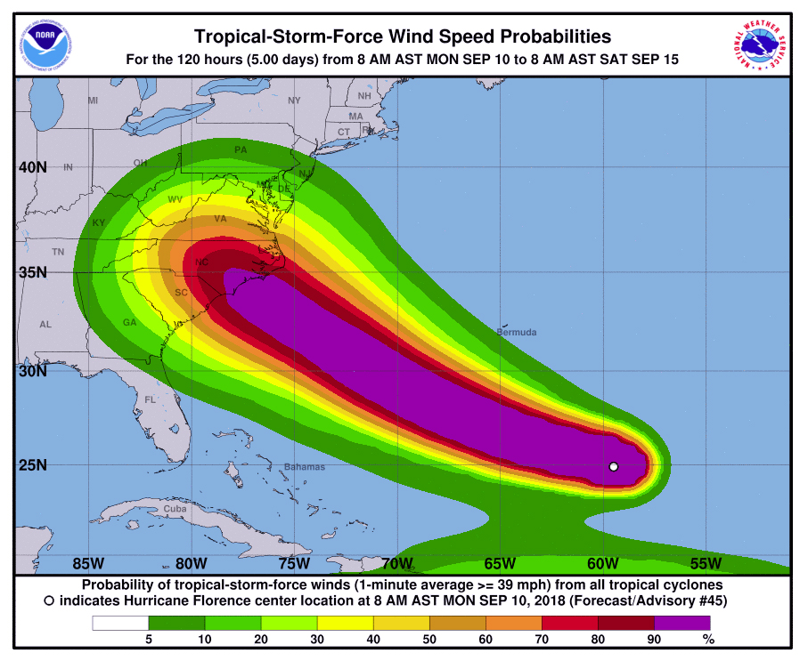
We Don’t Need Certainty
Instead: think about risk management!

Slide 13


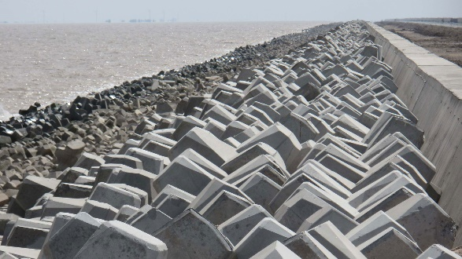
Adaptation Options
Resistance
Resilience
Transition
Reduce impacts/ Maintain current system
Promote change, reduce future risk

Slide 14
Adaptation Workbook: Benefits
Hands-on training
Taking a fresh look at each project area
Team members each get to consider their part of the Proposed Action
Opportunity to share ideas and listen to each other

Slide 15
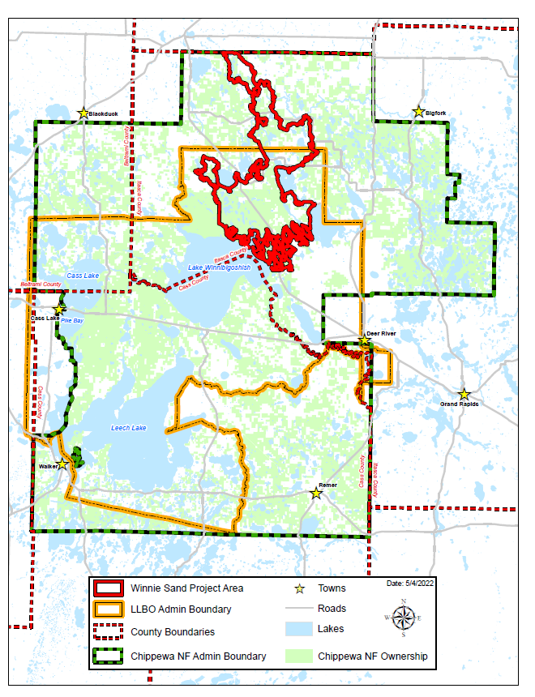
Gameplan for Winnie Sand

Slide 16
Adaptation Workbook
1. DEFINE management objectives.
5. MONITOR and evaluate effectiveness.
2. ASSESS climate impacts.
4. IDENTIFY adaptation approaches.
3. EVALUATE management objectives.
Swanston and Janowiak 2012; www.nrs.fs.fed.us/pubs/40543
Notes:
Adaptation will be driven by individual goals, forest conditions, and site characteristics
It’s the first step of the process
One of the benefits – putting the whole thought process together. Documentation AND opportunities to be creative, identify win-win opportunities as well as new ideas on adaptation.

Slide 17
Adaptation Workbook
Pre-work!
1. DEFINE management objectives.
5. MONITOR and evaluate effectiveness.
2. ASSESS climate impacts.
4. IDENTIFY adaptation approaches.
3. EVALUATE management objectives.
Swanston and Janowiak 2012; www.nrs.fs.fed.us/pubs/40543
Notes:
Adaptation will be driven by individual goals, forest conditions, and site characteristics
It’s the first step of the process
One of the benefits – putting the whole thought process together. Documentation AND opportunities to be creative, identify win-win opportunities as well as new ideas on adaptation.

Slide 18
Step 1 Prep
Write down your key management goals and objectives for your resource area!
Resource Areas | Goals (Made-up examples…) | Objectives
Vegetation/ Silviculture | Address the aspen and paper birch “age class bubble” across the district and regenerate young stands Convert aspen to long-lived species in some places Regenerate areas of spruce and fir that have been damaged by spruce budworm or experiencing decline. | How/ where/ how much?
Wildlife | Increase large white pine for eagle nest sites Prevent brush encroachment into marshes Restore waterfowl habitat and wild rice production within Summit and Cyrus lakes | How/ where/ how much?
Aquatic resources | Maintain coldwater trout habitat Correct AOP barriers | How/ where/ how much?

Slide 19
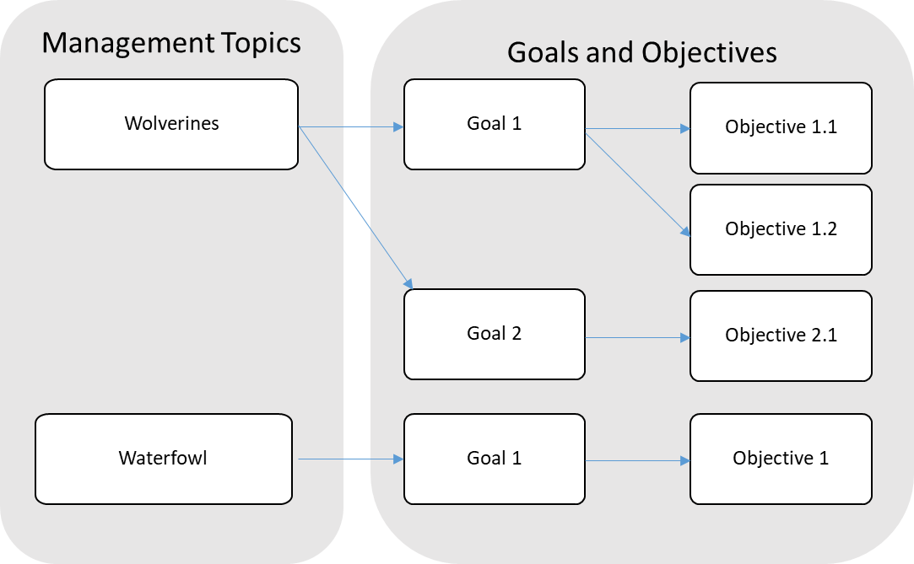
Step 1 Prep
Goals and Objectives are connected

Slide 20
SMART Objectives
Establish 191 acres of seedling/sapling stands with at least a 50% oak component.
Create 362 acres of young forest, to bring the young forest component in the project area to 10% of total forested acreage.
Replace 10 stream crossings that are a barrier to aquatic organism passage with structures that enhance connectivity and flood resilience
Specific
Measurable
Achievable
Relevant
Time bound
www.forestadaptation.org

Slide 21
Things to Avoid
Example Objective:
Objective 2. Increase mixed forest, heterogeneity and complexity, through the implementation of fire.
Issue: Too general for a large landscape. Can you provide a more specific search image?
Re-write(?): 1. Increase heterogeneity and complexity of jack pine and red pine forests by conducting prescribed fire on 2,000 acres per year with a tribally-led fire crew. 2. Increase application of prescribed fire on national forest land through partnership agreements.
Notes:
It’s important that you pick a project that isn’t so big that it’s overwhelming, and not so small you have nothing to say.
It’s a balance to find a project that is the right fit for the course. The course does go by quickly!
The simpler the project is conceptually the better, although all projects can have a certain amount of complexity – it’s a sliding scale.
From past courses, we’ve found that projects on the scale of perhaps 20 acres to a few hundred acres work well for this course. Sizes of projects that work well could include
A forest stewardship plan for a private woodlot, as long as the woodlot isn’t too huge
A management plan for a few stands or compartments
A timber sale
One forest type or issue in an area or ownership– for example, you might want to think about how you’d respond to responding to an out break of EAB, HWA, SPB, or another pest on 10s-100s of acres. Another example might be to focus on creating or improving a particular type of wildlife habitat within a larger landscape or ownership– so you might look at something like early-successional habitat or habitat for a particular species across a larger scale.
The trick is to find a balance where you have one or a few ecosystem types and a handful of objectives for each. Your project can cover a larger area if the area is fairly homogenous and not too complex. If you have a really complex ecosystem or issue, you might need to work at a finer scale.
We can use the same workbook process on larger projects– we’ve used it on projects with the Forest Service to 40,000 acres and even modified it to look at the entire natural resources program for the PA DCR– but those projects are too big an complex to be completed within the online class format.
We are always here to help if you’re struggling with the scale of a desired project!

Slide 22
Things to Avoid
Example Objective:
Carry out secretive marshbird and migratory waterfowl monitoring to better relate vegetation and invasive species management to occupancy
Issue: Not a management action, this is monitoring/ assessment. (We’ll cover this later in the process)
Notes:
It’s important that you pick a project that isn’t so big that it’s overwhelming, and not so small you have nothing to say.
It’s a balance to find a project that is the right fit for the course. The course does go by quickly!
The simpler the project is conceptually the better, although all projects can have a certain amount of complexity – it’s a sliding scale.
From past courses, we’ve found that projects on the scale of perhaps 20 acres to a few hundred acres work well for this course. Sizes of projects that work well could include
A forest stewardship plan for a private woodlot, as long as the woodlot isn’t too huge
A management plan for a few stands or compartments
A timber sale
One forest type or issue in an area or ownership– for example, you might want to think about how you’d respond to responding to an out break of EAB, HWA, SPB, or another pest on 10s-100s of acres. Another example might be to focus on creating or improving a particular type of wildlife habitat within a larger landscape or ownership– so you might look at something like early-successional habitat or habitat for a particular species across a larger scale.
The trick is to find a balance where you have one or a few ecosystem types and a handful of objectives for each. Your project can cover a larger area if the area is fairly homogenous and not too complex. If you have a really complex ecosystem or issue, you might need to work at a finer scale.
We can use the same workbook process on larger projects– we’ve used it on projects with the Forest Service to 40,000 acres and even modified it to look at the entire natural resources program for the PA DCR– but those projects are too big an complex to be completed within the online class format.
We are always here to help if you’re struggling with the scale of a desired project!

Slide 23
Things to Avoid
Example Goal:
Proactively employ science-based management actions to adapt to the effects of a warming climate.
Issue: Goals and objectives don’t need to state the desire for adaptation. (Adaptation helps you find ways to attain your goals and objectives.)
Notes:
It’s important that you pick a project that isn’t so big that it’s overwhelming, and not so small you have nothing to say.
It’s a balance to find a project that is the right fit for the course. The course does go by quickly!
The simpler the project is conceptually the better, although all projects can have a certain amount of complexity – it’s a sliding scale.
From past courses, we’ve found that projects on the scale of perhaps 20 acres to a few hundred acres work well for this course. Sizes of projects that work well could include
A forest stewardship plan for a private woodlot, as long as the woodlot isn’t too huge
A management plan for a few stands or compartments
A timber sale
One forest type or issue in an area or ownership– for example, you might want to think about how you’d respond to responding to an out break of EAB, HWA, SPB, or another pest on 10s-100s of acres. Another example might be to focus on creating or improving a particular type of wildlife habitat within a larger landscape or ownership– so you might look at something like early-successional habitat or habitat for a particular species across a larger scale.
The trick is to find a balance where you have one or a few ecosystem types and a handful of objectives for each. Your project can cover a larger area if the area is fairly homogenous and not too complex. If you have a really complex ecosystem or issue, you might need to work at a finer scale.
We can use the same workbook process on larger projects– we’ve used it on projects with the Forest Service to 40,000 acres and even modified it to look at the entire natural resources program for the PA DCR– but those projects are too big an complex to be completed within the online class format.
We are always here to help if you’re struggling with the scale of a desired project!

Slide 25
Adaptation Workbook
1. DEFINE management objectives.
5. MONITOR and evaluate effectiveness.
2. ASSESS climate impacts.
4. IDENTIFY adaptation approaches.
3. EVALUATE management objectives.
Swanston and Janowiak 2012; www.nrs.fs.fed.us/pubs/40543
Notes:
Adaptation will be driven by individual goals, forest conditions, and site characteristics
It’s the first step of the process
One of the benefits – putting the whole thought process together. Documentation AND opportunities to be creative, identify win-win opportunities as well as new ideas on adaptation.

Slide 26
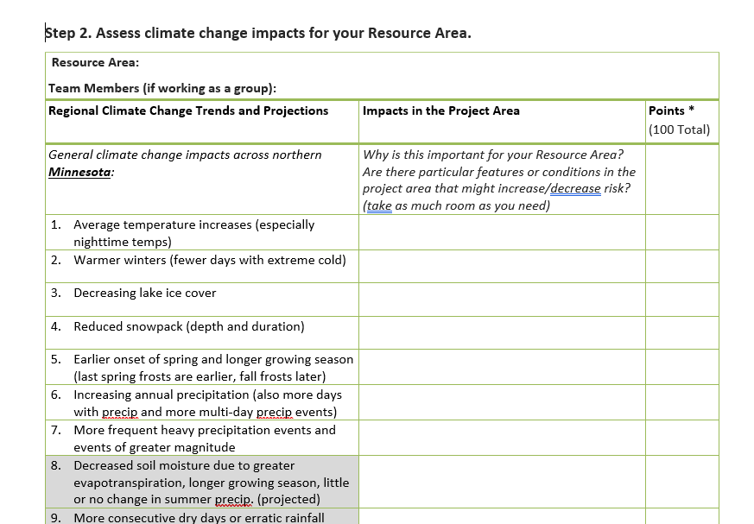
Step 2 Prep
Which climate change impacts are most important (positive or negative) for your resource area?
Are there particular features or conditions within the project area that might increase/decrease climate risk?

Slide 27
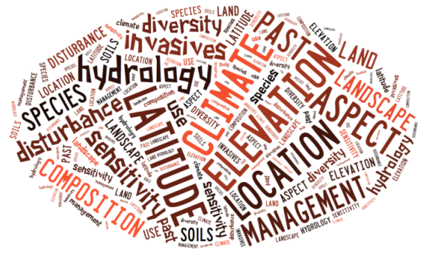
Regional to Site-Specific
Research and assessments describe broad trends but local conditions and management make the difference.

Slide 28
Regional to Site-Specific

Slide 30
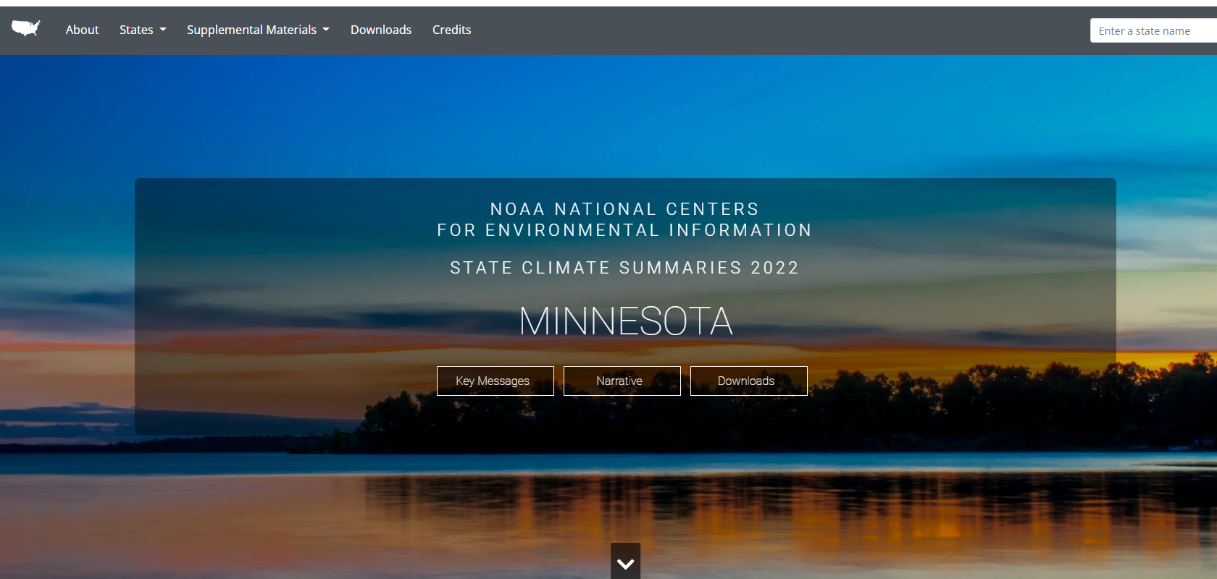
NOAA State Climate Summaries
https://statesummaries.ncics.org/

Slide 31
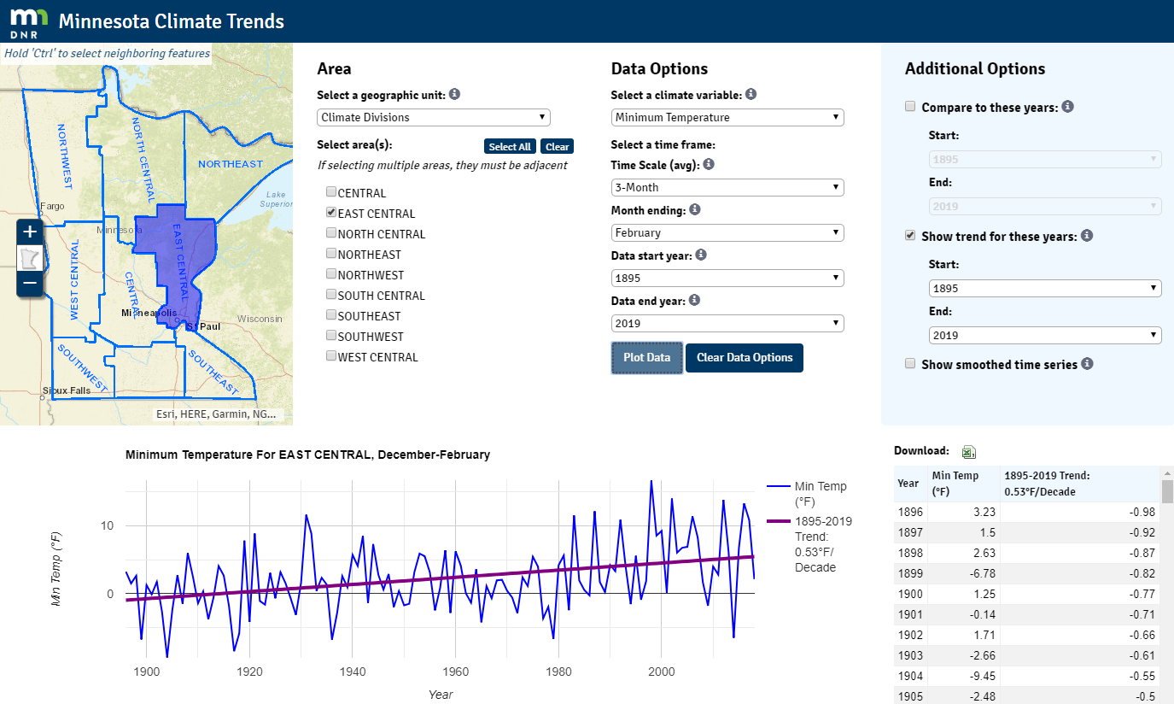
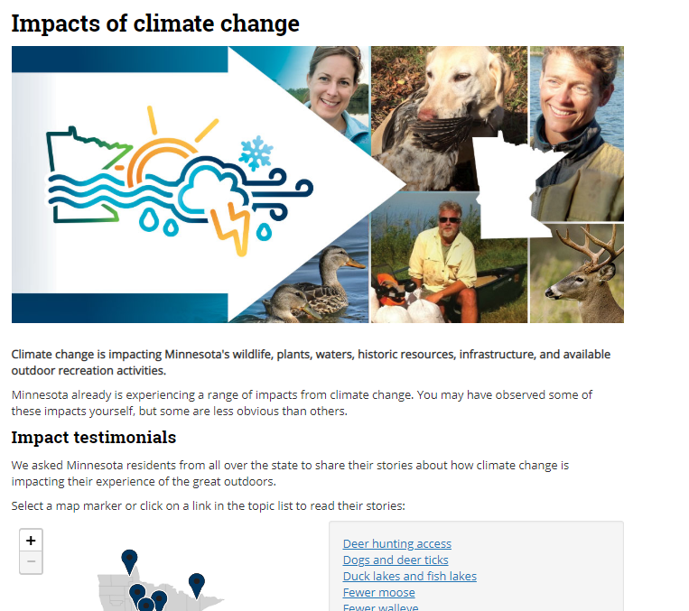
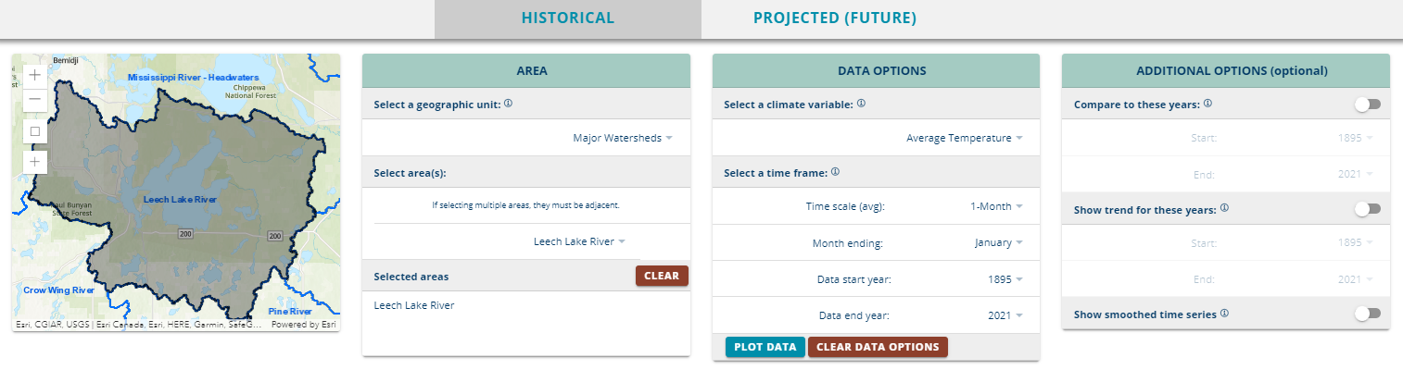
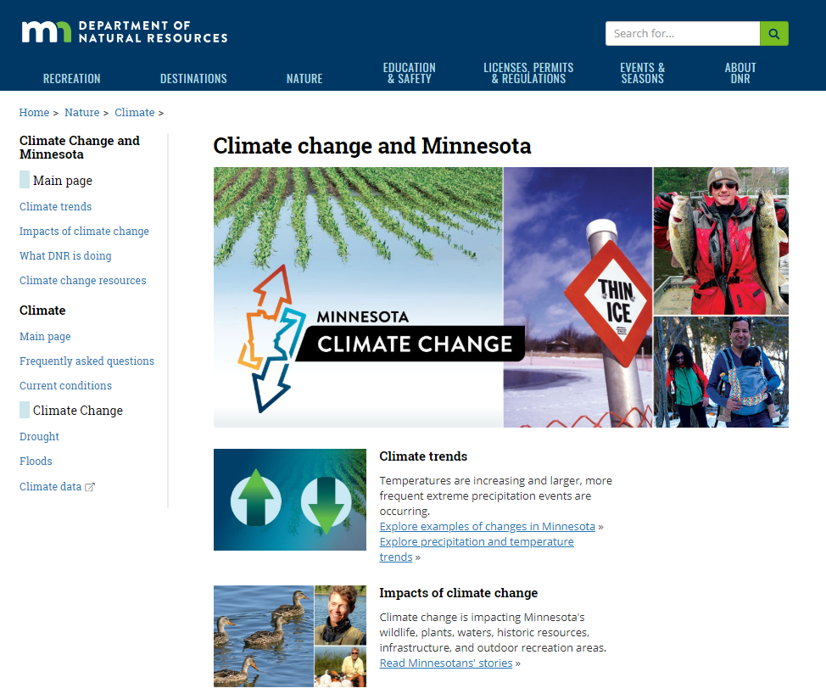
Minnesota Climate Explorer
  DNR page
  Real-world climate impacts!
  Climate info by county, watershed, or region
https://arcgis.dnr.state.mn.us/ewr/climateexplorer/main/historical

Slide 32
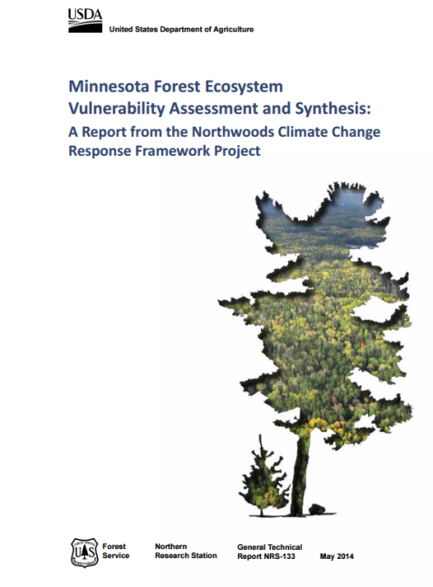
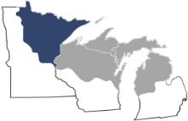
Forest Ecosystem Vulnerability Assessment
  Examine a range of future climates
  Do not make recommendations
  Sources of information:
    Models
    Published research
    Local managers and experts
Download: www.nrs.fs.fed.us/pubs/45939

Slide 33

Climate change recap: The BIG THREE
Annually: warmer and wetter
Warmer winters
More heavy rain
www.facebook.com/ChippewaNF
Source: Kenny Blumenfeld, Kenneth.Blumenfeld@state.mn.us

Slide 34
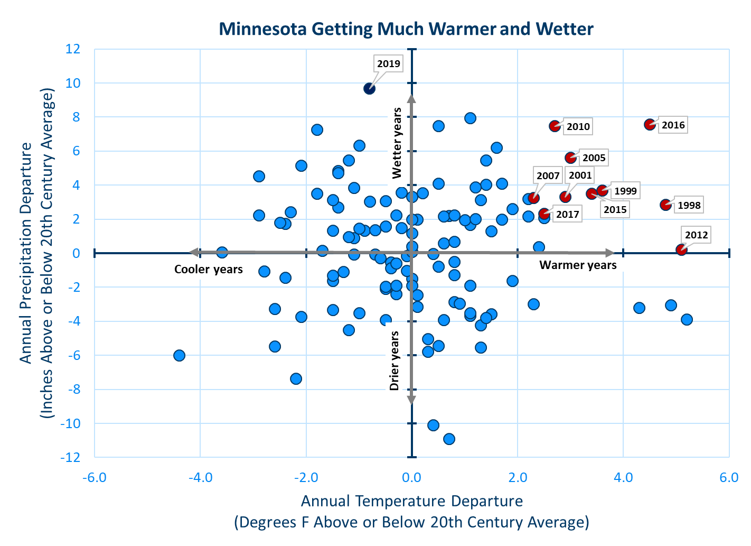

Wetter and Warmer Conditions Observed
Notes:
Minnesota has shifted to a much wetter and warmer climate in the past several decades. Compared to 20th century averages, all but two years since 1970 have been some combination of wet and/or warm, and each of the ten combined wettest and warmest years on record all occurred from 1998 onward. Although the climate will to vary from year to year, with occasional cool or dry years, climate scientists expect these increases to continue through the 21st century.

Slide 35
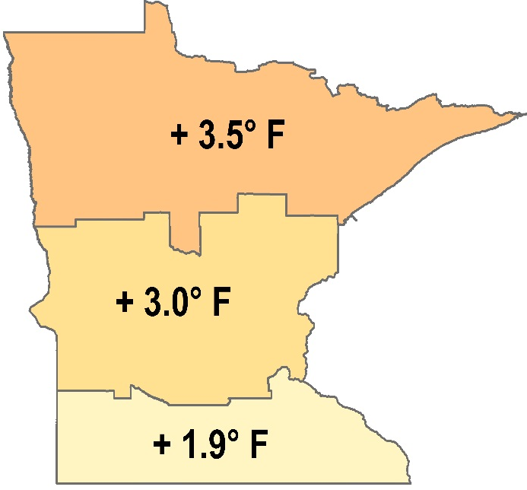
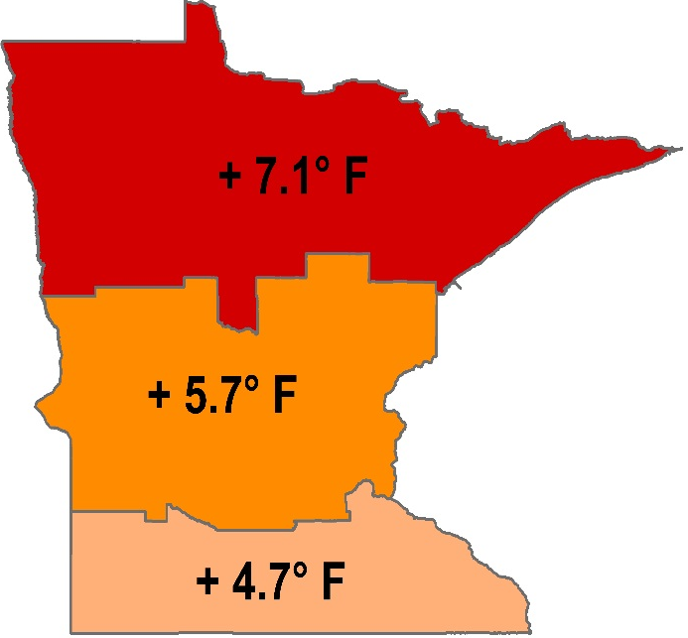
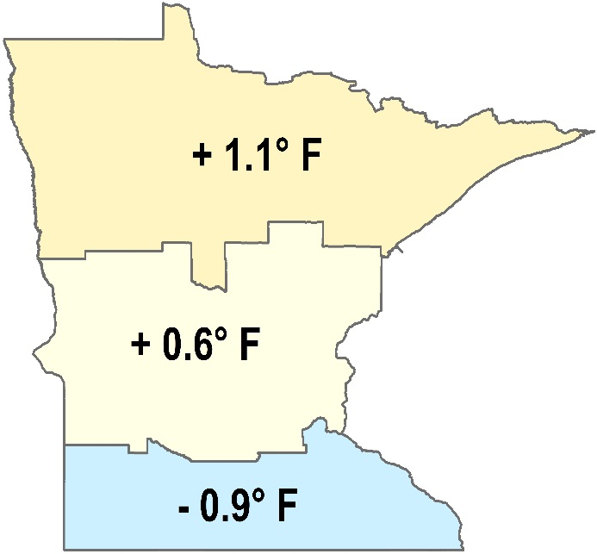
Warmer winters: where the action is
Total temperature change, 1895 – 2019
Annual Average Winter Lows Summer Highs

Slide 36
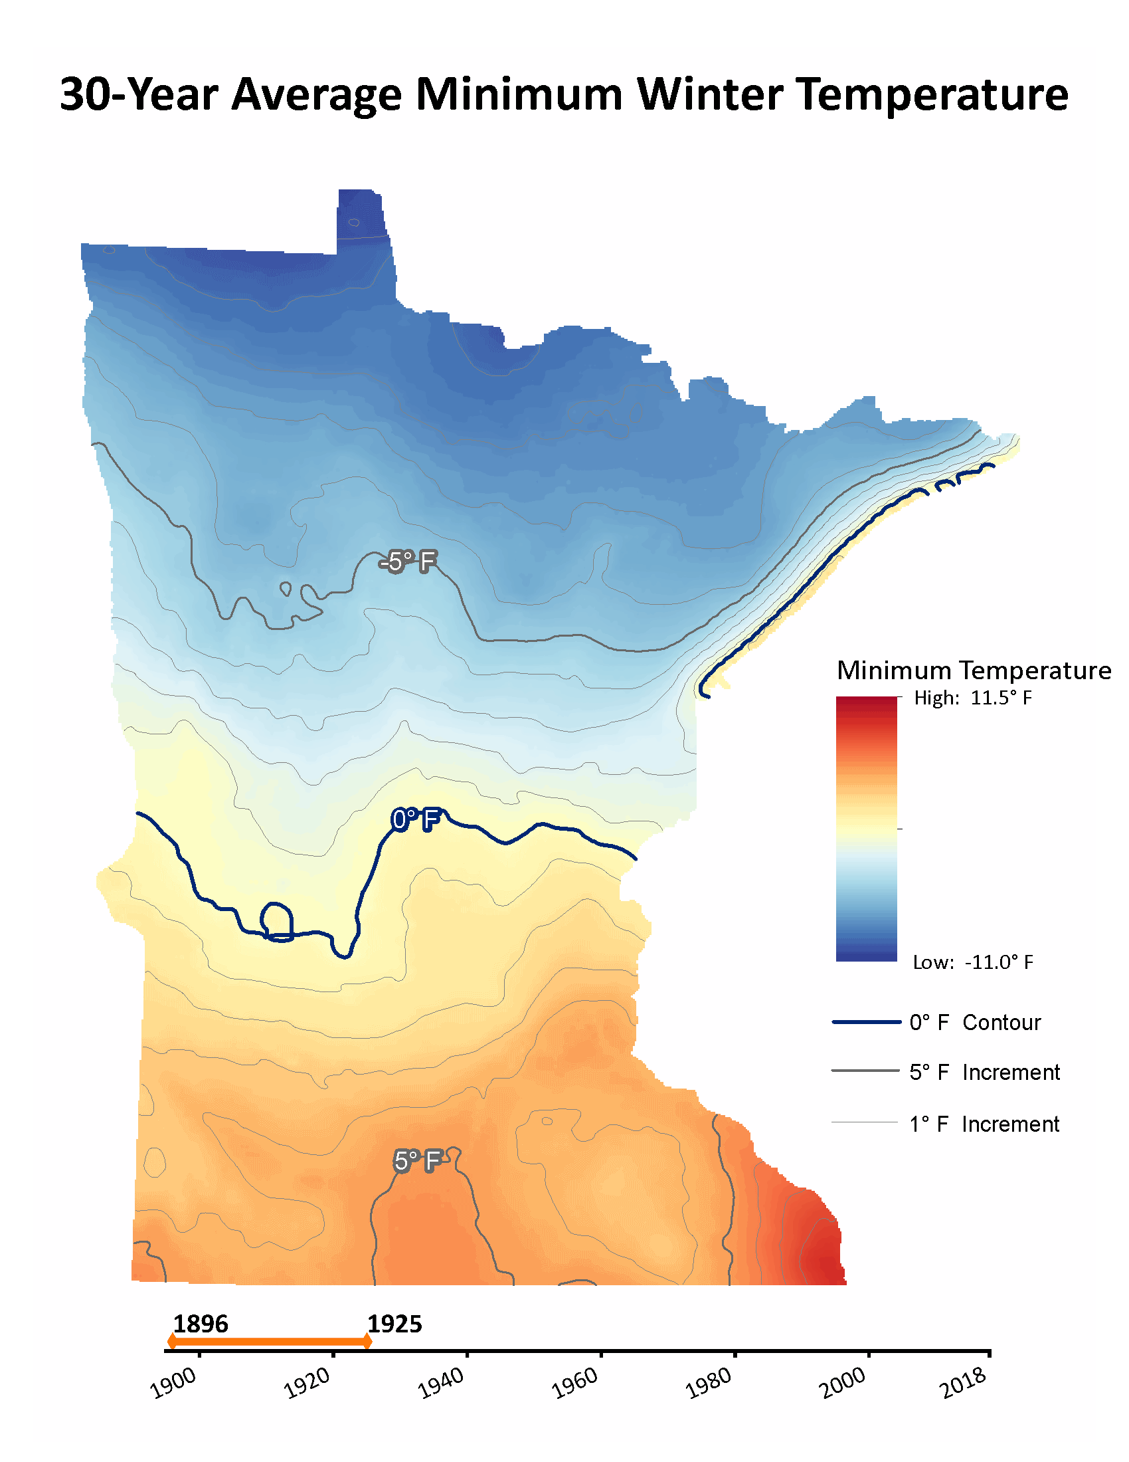
Warmer winters: where the action is
Courtesy B. Gosack,
MN DNR WHAF program

Slide 37
Warmer winters: cold extremes are vanishing

Slide 38
Warmer winters: lake ice
Long-term state-avg decline is 1.8 days per decade
Decline from 1987-2017 is 4.2 days per decade

Slide 39
Heavy rainfall: 1-inch events
Notes:
Minnesota has shifted to a much wetter and warmer climate in the past several decades. Compared to 20th century averages, all but two years since 1970 have been some combination of wet and/or warm, and each of the ten combined wettest and warmest years on record all occurred from 1998 onward. Although the climate will to vary from year to year, with occasional cool or dry years, climate scientists expect these increases to continue through the 21st century.

Slide 40
Heavy rainfall: 4-inch events
Notes:
Minnesota has shifted to a much wetter and warmer climate in the past several decades. Compared to 20th century averages, all but two years since 1970 have been some combination of wet and/or warm, and each of the ten combined wettest and warmest years on record all occurred from 1998 onward. Although the climate will to vary from year to year, with occasional cool or dry years, climate scientists expect these increases to continue through the 21st century.

Slide 41
Heavy rainfall: Max rainfall is getting larger
Notes:
Minnesota has shifted to a much wetter and warmer climate in the past several decades. Compared to 20th century averages, all but two years since 1970 have been some combination of wet and/or warm, and each of the ten combined wettest and warmest years on record all occurred from 1998 onward. Although the climate will to vary from year to year, with occasional cool or dry years, climate scientists expect these increases to continue through the 21st century.

Slide 43
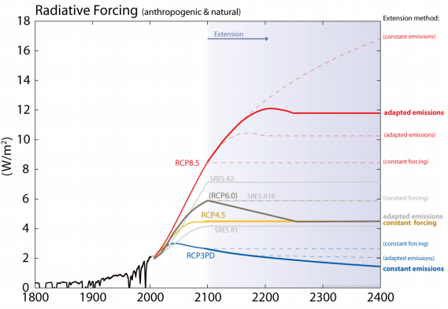
Representative Concentration Pathways (RCPs)

Slide 44

Known Unknowns
Two main sources of uncertainty in climate projections:
Climate models
Future greenhouse gas emissions

Slide 45
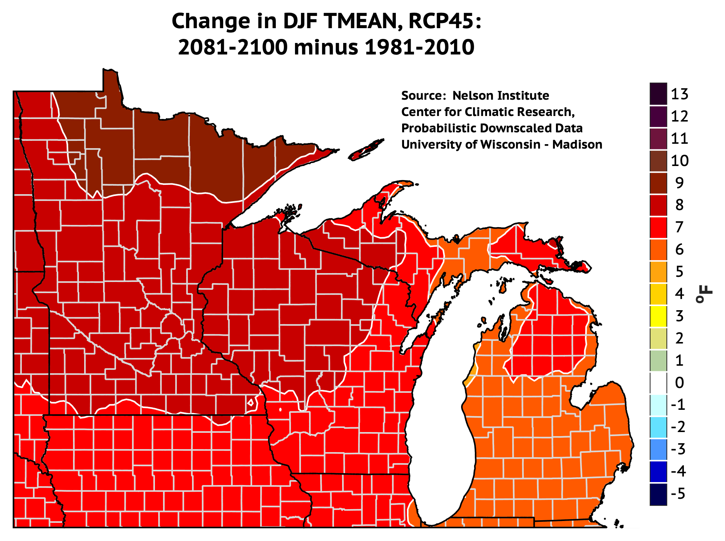
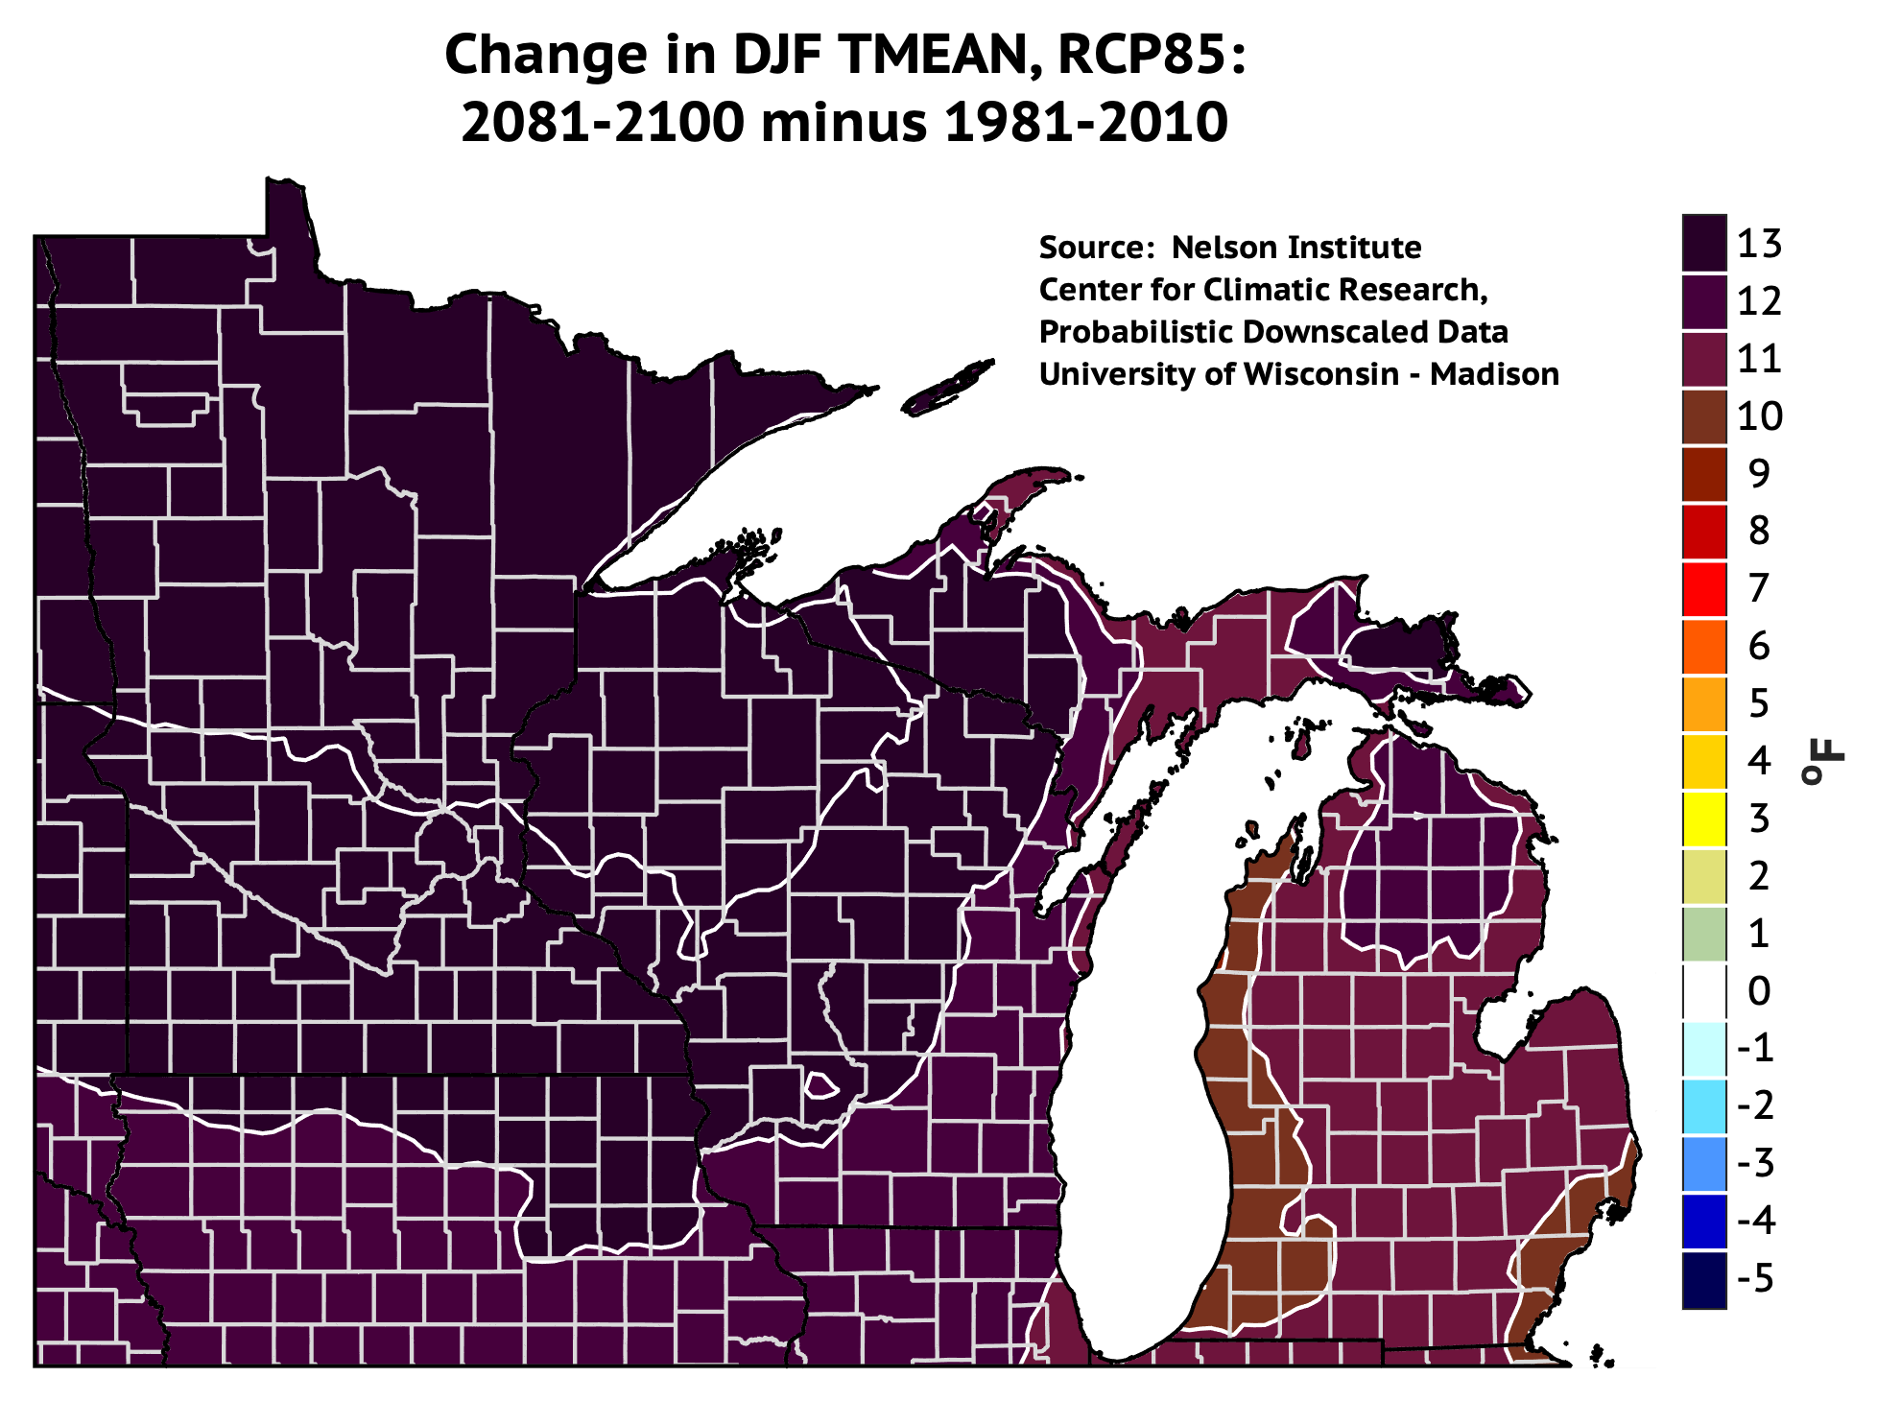
Future Projections: Winter Mean Temp

Slide 46
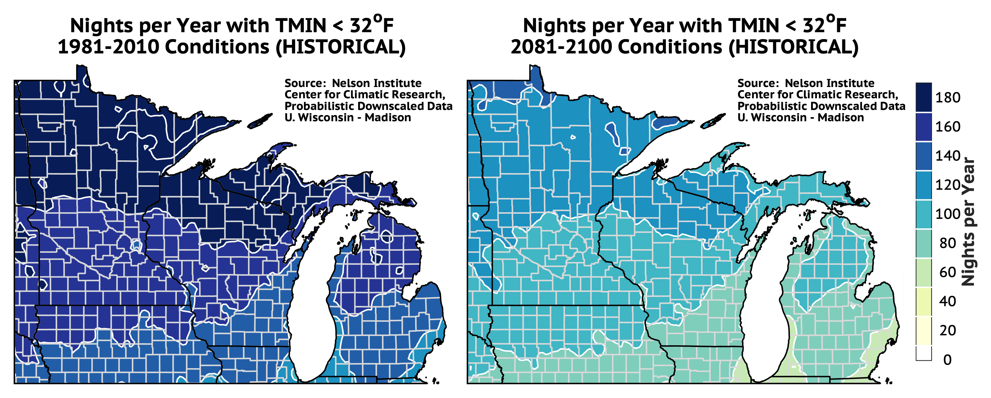
Growing Season - Projected
Sources: http://ccr.aos.wisc.edu/resources/data_scripts/dyndown
Notes:
First fall frost moving later in the year by roughly the same amount…..

Slide 47
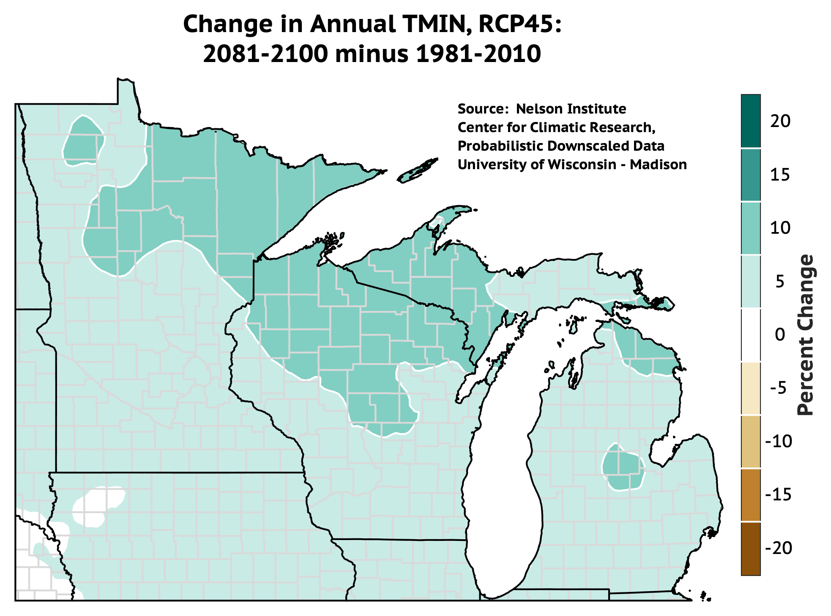
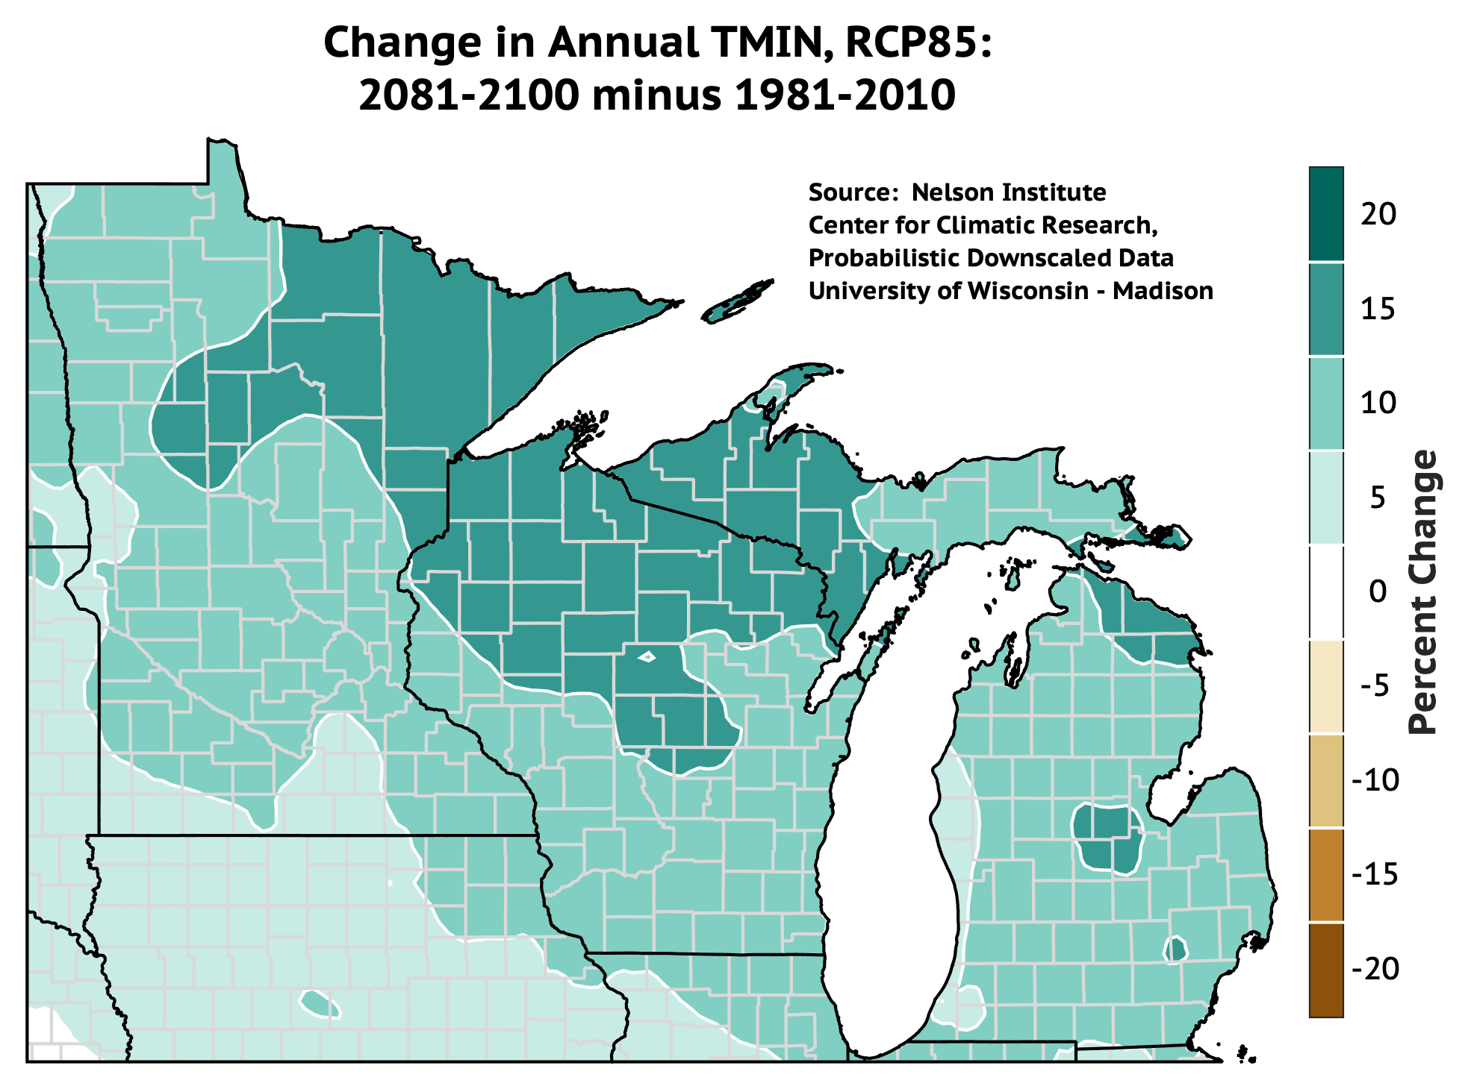
Future Projections: Annual Precip
PRCP
PRCP

Slide 48
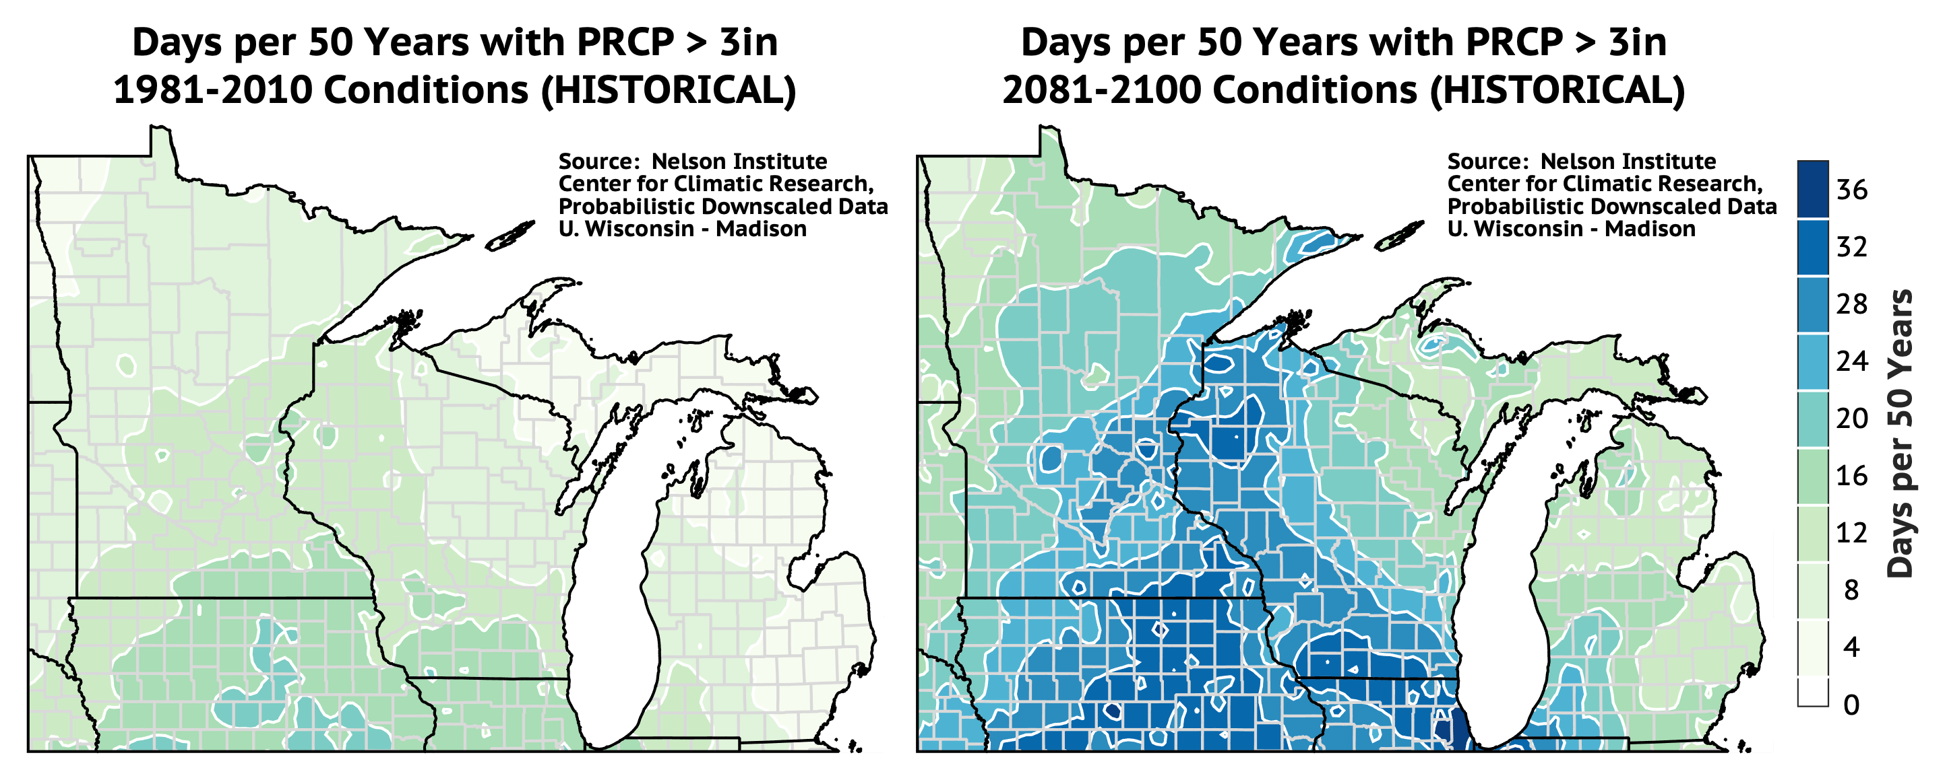
Heavy Precipitation - Projected
Notes:
Notaro RegCM4
25km grid size

Slide 49
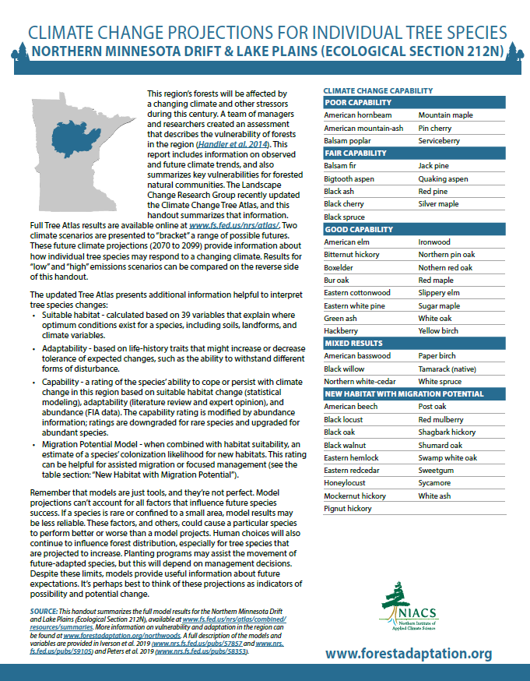
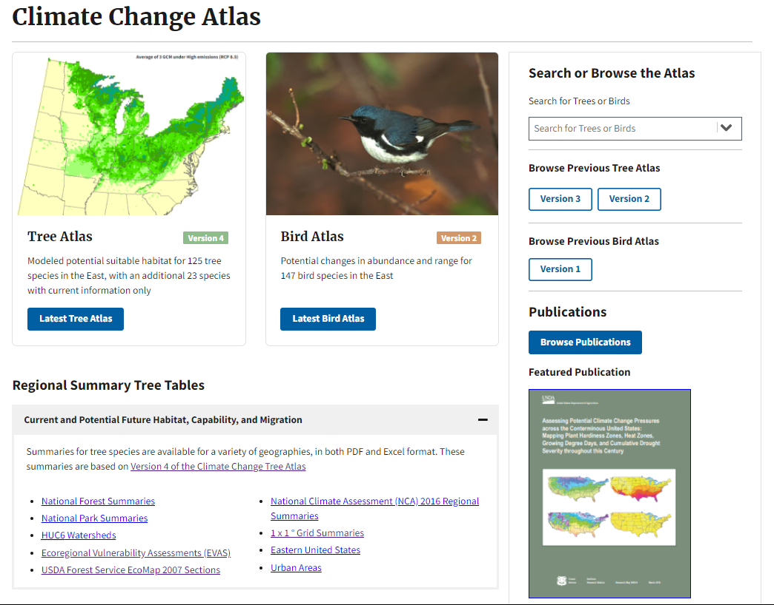
Climate Change Tree Atlas Results
www.fs.fed.us/nrs/atlas
Notes:
Tamarack – show species page, results maps, also combined results. TALK ABOUT HOW THE OUTLOOK IS BETTER

Slide 50
Climate Change Tree Atlas Results
Increasing Habitat
American basswood
Bitternut hickory
Bur oak
Eastern white pine
Northern red oak
Sugar maple
Deceasing Habitat
Balsam poplar
Black spruce
Jack pine
Quaking aspen
New Migrants
Black walnut
Eastern hemlock
Shagbark hickory
Swamp white oak
Sycamore
https://forestadaptation.org/learn/resource-finder/tree-species-projections-ecological-sections-minnesota
Notes:
Tamarack – show species page, results maps, also combined results. TALK ABOUT HOW THE OUTLOOK IS BETTER

Slide 51



Changes in Forest Composition
= species X quality habitat
50% Reduction in Habitat:
Habitat reduced equally
Best habitats remain

Slide 52

Changes in Forest Composition
Many common tree species are projected to have reduced suitability in the future
Changes will occur slowly—not instant dieback
Mature and established trees should fare better
Immense lags to occupy habitats
Critical factors: competition, management, & disturbance

Slide 53
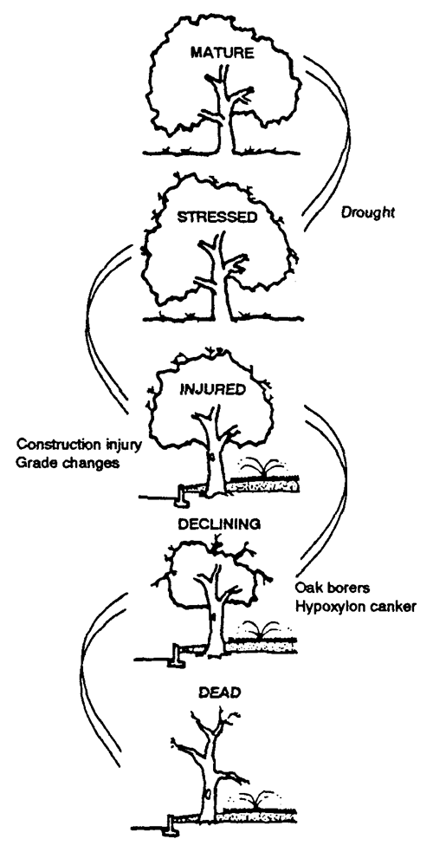




A “Threat Multiplier”
Interactions can trigger big changes
  Stress
  Disturbance
  Invasive species
  Insect pests
  Forest diseases
Drought
Injury
Pests and Disease
Bartlett Tree Experts

Slide 54
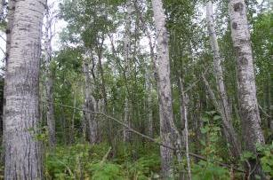
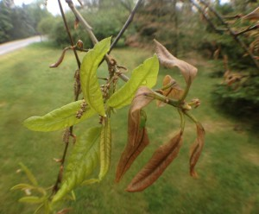
Longer Growing Season
Benefits:
More time for growth!
Limits:
Early bud break/loss of cold hardening
Frost damage with spring frosts
Benefits to pests and non-native species
  Ainsworth and Long 2005, Ainsworth and Rogers 2007, Norby and Zak 2011

Slide 55
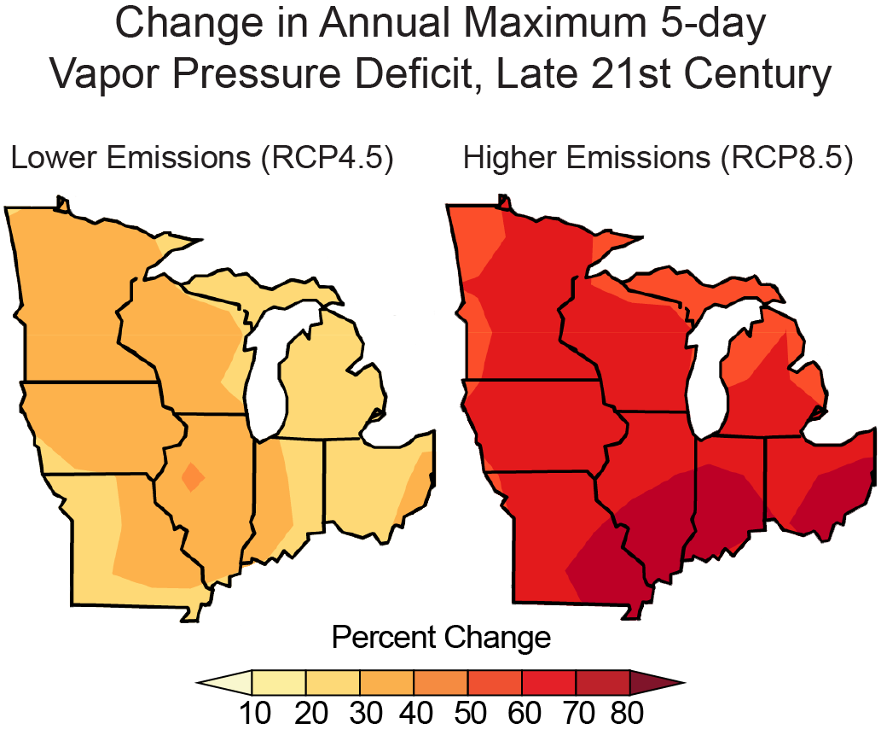
More Drought Stress
Liqiang Sun and Ken Kunkel, Cooperative Institute for Climate and Satellites

Slide 56
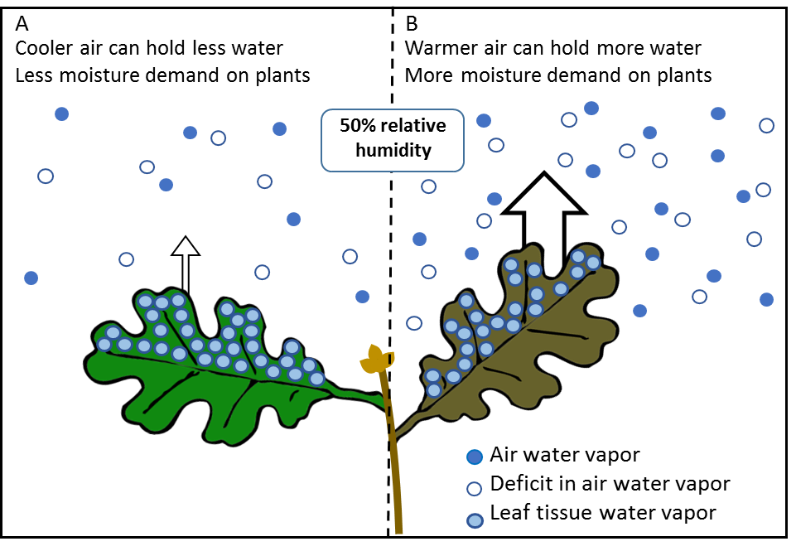
More Drought Stress
Notes:
FIGURE CAPTION: Impacts of projected changes to vapor pressure deficit (VPD) on the drying effect of air on plants and soils. (A) Cooler air can hold less moisture than (B) warmer air. At the same relative humidity (e.g., 50% air saturation), warmer air has more demand on leaf water from the greater deficit in water vapor in air. (C) Change in the moisture deficit of the air based on projected maximum five-day VPD by the late 21st Century for low and high emissions.

Slide 57

More Drought Stress
Greater uncertainty about future precipitation, but great risk of summer moisture stress
Water loss from trees (transpiration)
Precipitation
Intense precipitation
Water loss from soils (evaporation)
Runoff
Groundwater recharge

Slide 58
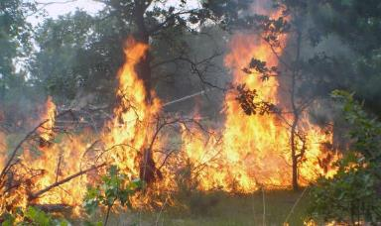
Wildfire Risk
Fire may increase, because:
Warmer/drier summers
Increased mortality from stress, pests, events
More frequent weather conditions that promote large fires
FWI = Fire Weather Index values
Guyette et al. 2014, Tang et al. 2014, Miranda et al. 2012, Moritz et al. 2012, Nowacki et al. 2014, Kerr et al. 2017

Slide 59

Wildfire Risk
Fire may increase, because:
Warmer/drier summers
Increased mortality from stress, pests, events
More frequent weather conditions that promote large fires
…or maybe not, because:
Fire suppression will continue
Spring/early summer moisture
Current regeneration of more mesic species
Spatial patterns of land use and fragmentation
Source: Guyette et al. 2014, Tang et al. 2014, Miranda et al. 2012, Moritz et al. 2012, Nowacki et al. 2014

Slide 60

Prescribed Fire Application
Will it be easier or harder to use this tool?
Warmer, drier conditions may support prescribed fire and lengthen the window of opportunity for burning.
Conversely, widespread tree mortality, wetter conditions, and on-going mesophication could limit local prescribed fire implementation.
Prescribed fire depends on advanced planning and staff availability, so erratic conditions will be a serious challenge.

Slide 61


Extreme Wind Events
Extreme events are rare and hard to model.
Uncertainty is very high
High wind events may increase in northern latitudes (above 40-50⁰)
Average wind speeds may decrease slightly across the central US
Regeneration may not follow the usual pattern
Gastineau and Soden 2009, Kumar et al. 2015, Karnauskas et al. 2018

Slide 62


Invasive Species
Stress and disturbance creates more opportunity.
Invasive species may be better able to take advantage of new conditions (expanded ranges, elevated CO₂, etc.)

Slide 63



Pests and Diseases
Existing pests and diseases cause more damage
Pests and diseases may expand to new locations
Seasonal timing may shift

Slide 64

Forest Type Vulnerability
Acid peatland
Forested rich peatland
Wet forest
Lowland conifer
Upland spruce-fir
Upland spruce-fir
Lowland conifer
Red pine/ white pine Jack pine
Aspen-birch
Northern hardwoods
Lowland/riparian hardwoods
Aspen-birch
Lowland/riparian hardwoods
Red pine
Northern hardwoods
Jack pine
Managed aspen
Managed red pine
Fire-dependent forest
Mesic hardwood forest
Oak
White pine
Oak associations
Barrens
Floodplain forest
Download: www.forestadaptation.org

Slide 65
Regional to Site-Specific
Research and assessments describe broad trends but local conditions and management make the difference.

Slide 66
Next Steps
Stephen will share today’s presentation and recording
Stephen will share pre-work worksheets
Complete pre-work by Friday, May 20 (email to Stephen)
Adaptation Workbook sessions May 23-27 (TBD)
Get in touch with questions!
www.forestadaptation.org

Slide 67


Thank you!
Climate Hubs
Climate Change Resource Center
Climate Change Atlas
NIACS Resources
www.climatehubs.oce.usda.gov
www.fs.usda.gov/ccrc
www.fs.fed.us/nrs/atlas/
www.forestadaptation.org/

Slide 68

Climate Change Response Framework
www.forestadaptation.org

Slide 69

Streamflow Changes
High-flow days become much more common in winter and spring
Low-flow days become much more common in summer and fall
Cherkauer and Sinha 2010, also Christiansen et al. 2014
Notes:
50-120% more runoff in winter compared to baseline conditions!
Christiansen – Jan and Feb and March flows higher than baseline, (combined flow into lake Michigan)
Christiansen - April May June July flows lower than baseline

Slide 70

Pests and Diseases
Climate change can trigger more damage from pests.
Ray Grumney, Star Tribune. Photo: Fraser McKee

Slide 71
Climate Change Resource Center
Written and organized for land managers
Original content, links to tools and info
Credible, science based, relevant
https://www.fs.usda.gov/ccrc/

Slide 72



Climate vs. Weather
Notes:
Mood vs. Personality

Slide 73


Know Your Priorities
You can’t always get what you want

Slide 74

Next Steps/ Areas of Improvement
WO Carbon Templates
  Vetted and standardized way to publicly convey expected carbon effects of management
  Appropriate levels of certainty
  Templates designed to fit EA format
  Have withstood numerous objection reviews
Notes:
ALSO*** - FSC and SFI are both including updates in their standards to better recognize the rights and perspectives of indigenous people.

Slide 75

Assisted Migration: Definitions
  What do we mean by “assisted migration”?
Notes:
Brian and others made the case last week, ecologically. From management perspective, there has already been interest and actions being pursued in an ad hoc manner. We want to make decisions in an informed, coordinated manner. Not too much burden on individuals.
Talking about trees, not herbaceous plants. Also differentiate between types and what is acceptable. This relates to Brian’s presentation and the different risks associated with different tactics—planting existing species from more southerly sources, expanding range of uncommon species, assisted colonization—species from far outside their range.
Internal guidance document. Hope the info is relevant and applicable across agencies and organizations in northeastern Minnesota and that process/template can be used nationally.

Slide 76

Assisted Migration: Definitions
  What do we mean by “assisted migration”?
Notes:
Brian and others made the case last week, ecologically. From management perspective, there has already been interest and actions being pursued in an ad hoc manner. We want to make decisions in an informed, coordinated manner. Not too much burden on individuals.
Talking about trees, not herbaceous plants. Also differentiate between types and what is acceptable. This relates to Brian’s presentation and the different risks associated with different tactics—planting existing species from more southerly sources, expanding range of uncommon species, assisted colonization—species from far outside their range.
Internal guidance document. Hope the info is relevant and applicable across agencies and organizations in northeastern Minnesota and that process/template can be used nationally.

Slide 77

Assisted Migration: Definitions
  What do we mean by “assisted migration”?
Notes:
Brian and others made the case last week, ecologically. From management perspective, there has already been interest and actions being pursued in an ad hoc manner. We want to make decisions in an informed, coordinated manner. Not too much burden on individuals.
Talking about trees, not herbaceous plants. Also differentiate between types and what is acceptable. This relates to Brian’s presentation and the different risks associated with different tactics—planting existing species from more southerly sources, expanding range of uncommon species, assisted colonization—species from far outside their range.
Internal guidance document. Hope the info is relevant and applicable across agencies and organizations in northeastern Minnesota and that process/template can be used nationally.

Slide 78


Assisted Migration: Definitions
  What do we mean by “assisted migration”?
Silver maple
Notes:
Brian and others made the case last week, ecologically. From management perspective, there has already been interest and actions being pursued in an ad hoc manner. We want to make decisions in an informed, coordinated manner. Not too much burden on individuals.
Talking about trees, not herbaceous plants. Also differentiate between types and what is acceptable. This relates to Brian’s presentation and the different risks associated with different tactics—planting existing species from more southerly sources, expanding range of uncommon species, assisted colonization—species from far outside their range.
Internal guidance document. Hope the info is relevant and applicable across agencies and organizations in northeastern Minnesota and that process/template can be used nationally.

Slide 79


Assisted Migration: Definitions
  What do we mean by “assisted migration”?
Black walnut - current
Black walnut – 2100 (RCP 8.5)
Notes:
Brian and others made the case last week, ecologically. From management perspective, there has already been interest and actions being pursued in an ad hoc manner. We want to make decisions in an informed, coordinated manner. Not too much burden on individuals.
Talking about trees, not herbaceous plants. Also differentiate between types and what is acceptable. This relates to Brian’s presentation and the different risks associated with different tactics—planting existing species from more southerly sources, expanding range of uncommon species, assisted colonization—species from far outside their range.
Internal guidance document. Hope the info is relevant and applicable across agencies and organizations in northeastern Minnesota and that process/template can be used nationally.

Slide 80

Assisted Migration: Challenges
  Novel seed sources: new collectors or vendors, new procedures, tracking provenances, etc.
  Increased demand: Trillion Trees! Carbon storage! Less reliance on natural regeneration!
Notes:
Brian and others made the case last week, ecologically. From management perspective, there has already been interest and actions being pursued in an ad hoc manner. We want to make decisions in an informed, coordinated manner. Not too much burden on individuals.
Talking about trees, not herbaceous plants. Also differentiate between types and what is acceptable. This relates to Brian’s presentation and the different risks associated with different tactics—planting existing species from more southerly sources, expanding range of uncommon species, assisted colonization—species from far outside their range.
Internal guidance document. Hope the info is relevant and applicable across agencies and organizations in northeastern Minnesota and that process/template can be used nationally.

Slide 81
Adaptation is the adjustment of systems to respond to climate change.
Adaptation actions are designed to intentionally address climate change impacts and vulnerabilities in order to meet goals and objectives
Notes:
Before we dive into the course, let’s start by defining ADAPTATION (read slide)
the adaptation activities will build upon sustainable forest management and conservation IN MOST CASES. Much of what we’re already doing also makes good sense as a response to climate change.

Slide 82

Adaptation Workbook
1. DEFINE management objectives.
5. MONITOR and evaluate effectiveness.
2. ASSESS climate impacts.
4. IDENTIFY adaptation approaches.
3. EVALUATE management objectives.
Menu
Swanston and Janowiak 2012; www.nrs.fs.fed.us/pubs/40543
Notes:
Adaptation will be driven by individual goals, forest conditions, and site characteristics
It’s the first step of the process
One of the benefits – putting the whole thought process together. Documentation AND opportunities to be creative, identify win-win opportunities as well as new ideas on adaptation.

Slide 83


Adaptation Menus
A collection of plausible adaptation actions that is:
Specific to a discipline
Organized into a tiered hierarchy
Thorough and comprehensive (including opposing ideas!)
www.nrs.fs.fed.us/pubs/40543 and www.AdaptationWorkbook.org

Slide 84
Adaptation Menu Benefits
Address challenges in implementing adaptation:
Connecting broad ideas to specific actions
Communicating your ideas
Boosting creativity
www.nrs.fs.fed.us/pubs/40543 and www.AdaptationWorkbook.org

Slide 85

Adaptation Menus
1. Connecting Broad Ideas to Specific Actions
www.nrs.fs.fed.us/pubs/40543 and www.AdaptationWorkbook.org

Slide 86

Adaptation Menus
1. Connecting Broad Ideas to Specific Actions
www.nrs.fs.fed.us/pubs/40543 and www.AdaptationWorkbook.org

Slide 87

Adaptation Menus
1. Connecting Broad Ideas to Specific Actions
www.nrs.fs.fed.us/pubs/40543 and www.AdaptationWorkbook.org

Slide 88

Adaptation Menus
1. Connecting Broad Ideas to Specific Actions
www.nrs.fs.fed.us/pubs/40543 and www.AdaptationWorkbook.org

Slide 89

Adaptation Menus
2. Communicating your Ideas
wwww.forestadaptation.org

Slide 90

Adaptation Menus
2. Communicating your Ideas
wwww.forestadaptation.org

Slide 91

Adaptation Menus
3. Boosting Creativity
wwww.forestadaptation.org

Slide 92


A Growing Collection
Published:
Forestry
Urban Forestry
Agriculture
Forested Watersheds
Tribal Perspectives
Forest Carbon Management
Recreation
Non-forested Wetlands
Glacial Lakes Fisheries
In Preparation:
Wildlife Management
Coastal Ecosystems
Grasslands
Fire (western?)
Mix and Match:
Menus can be used independently or together in a single project!
www.forestadaptation.org/adapt/adaptation-strategies

Slide 93

Spotlight: Tribal Adaptation Menu
Foundation of indigenous values (respect, reciprocity, etc)
Ojibwe and Menominee perspectives, languages, concepts and values
Helps express climate adaptation ideas through an indigenous lens, AND expresses the adaptation benefits of indigenous practices
Communication tool for tribal and non-tribal partners
https://forestadaptation.org/learn/resource-finder/tribal-climate-adaptation-menu
Notes:
ALSO*** - FSC and SFI are both including updates in their standards to better recognize the rights and perspectives of indigenous people.

Slide 94

CO2 Fertilization
Benefits:
Increased growth
Water-use efficiency
Limits:
Other nutrients or water
Stressors or disturbance
  Ainsworth and Long 2005, Ainsworth and Rogers 2007, Norby and Zak 2011, Coture et al. 2015

Slide 95


Future Projections: Summer Mean Temp

